Slide 1

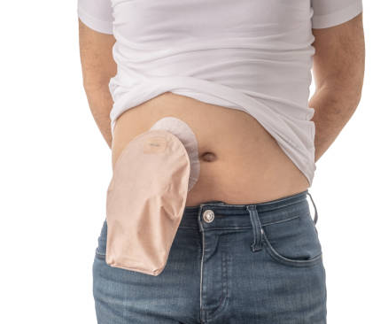
It is in the bag: what to do when we have a watery output?
Melissa oliveira cunha - Colorectal surgeon

Slide 2
What is a high output stoma?
When large bowel (colon) is removed the small bowel is not as efficient at absorbing fluid
If your output is high and you are losing more than 1500ml per day from your stoma, you are at greater risk of becoming dehydrated.
However over time your small bowel (ileum) is usually able to adapt to maintain hydration.
It may occur:
  Newly formed stoma
  Bowel is affected by disease or treatment
  Bowel is shortened

Slide 3
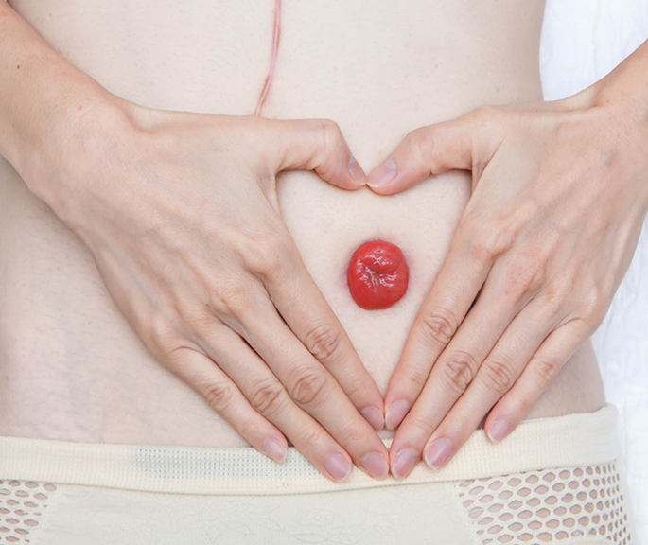
WHAT CONCERNS ARE associated with high output stomas?
Watery or high output stomas lead to rapid dehydration
Medications might not be absorbed
Salt imbalances
Malnutrition
Weight loss
Increased length of stay in hospitals
Recurrent admissions
Psychosocial factors, skin damage, poor quality of life

Slide 4
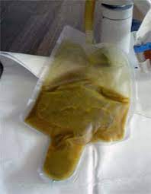
Signs and symptoms of high output stoma
Watery stoma output
Changing your stoma bag more often than usual
Possible leaking of stoma bags
Signs of dehydration

Slide 5
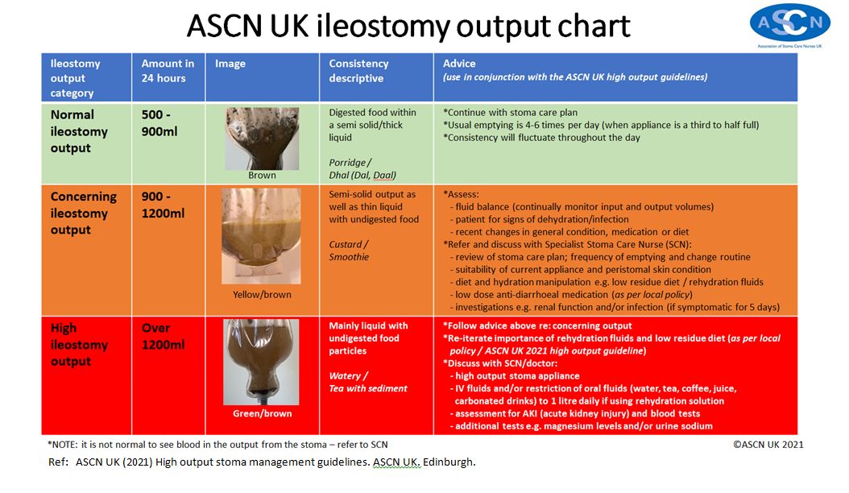

Slide 6
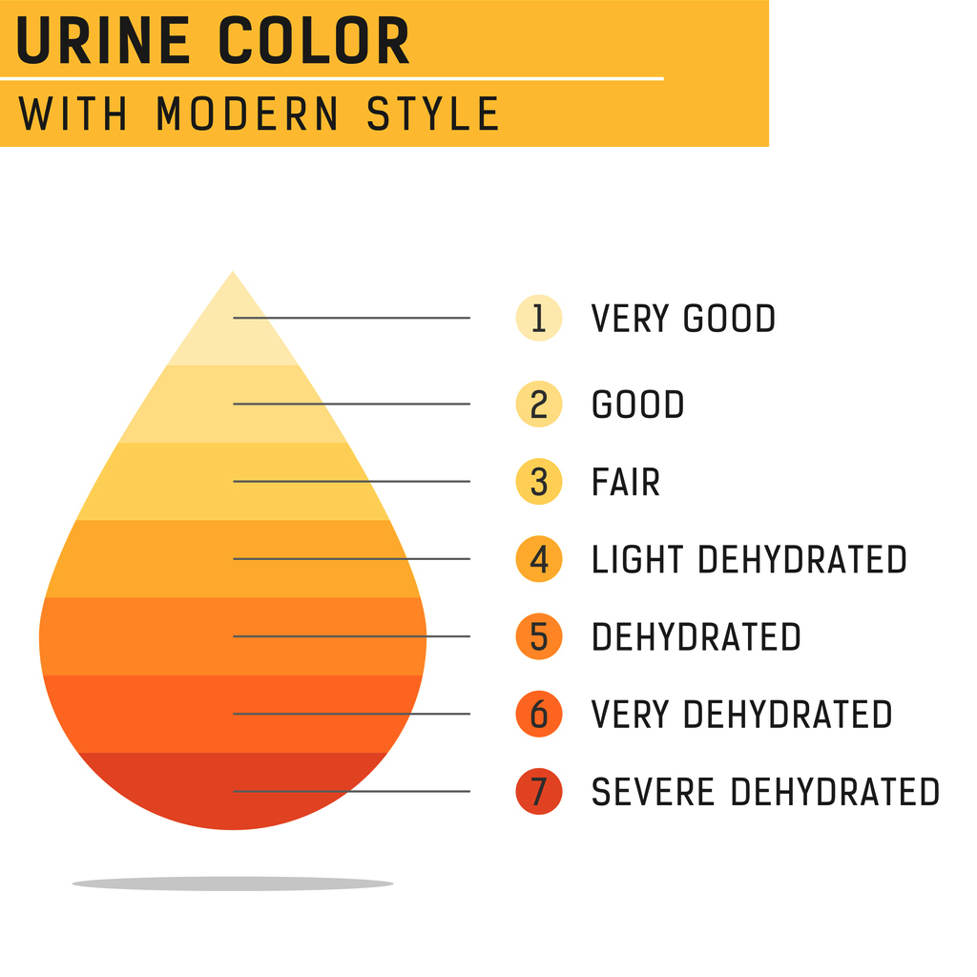
How do I recognise dehydration?
If you are dehydrated you may experience:
  Dry, sticky mouth
  Increased thirst
  Light headedness or feeling dizzy especially when going from sitting to standing
  Tiredness
  Headache
  Passing less urine which is dark or strong smelling
  Muscle cramps

Slide 7
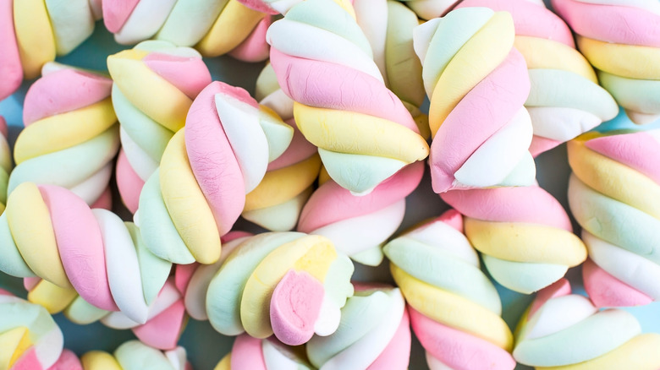

WHAT SHOULD I DO?
Your stoma output may be reduced by:
  Drinking less fluid and replacing it with an oral rehydration solution
  Increasing your salt intake
  Reducing your fibre intake
  Taking medication to reduce your output

Slide 8

whaT NOT DO?
DRINK MORE WATER!

Slide 9
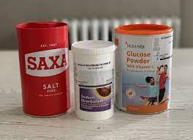
Rehydration solution
Reduced drinks to 1L
Rehydration solution:
  20g (six level 5ml spoonsful) of Glucose
  2.5g (one heaped 2.5ml spoonful) of Sodium Bicarbonate (baking soda)
  3.5g (one level 5 ml spoonful) of Sodium Chloride (salt)
  1L of water

Slide 10

REHYDRATION SOLUTION
Rehydration can be prescribed by GPS
You may find the solution tastes salty
This can be improved by:
  Storing the drink in the refrigerator and taking it chilled
  It can also be frozen and taken as a slush
  Sipping it through a straw
  Adding a small amount of squash, fruit juice or cordial
  Adding fresh lemon or lime juice

Slide 11
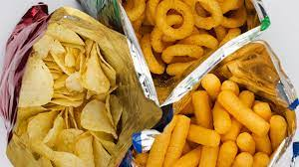
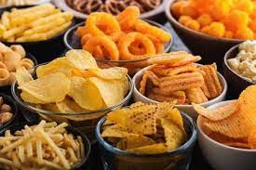
How can I increase my salt intake?
Each day you lose a lot of salt (sodium) from your stoma
You can increase your salt intake by:
  Using salt in cooking and adding salt to your meals
  Eating high salt foods like salty crisps, savoury biscuits and crackers, cheese, bacon, ham, smoked or tinned fish, sauces (for example tomato ketchup or brown sauce)

Slide 12
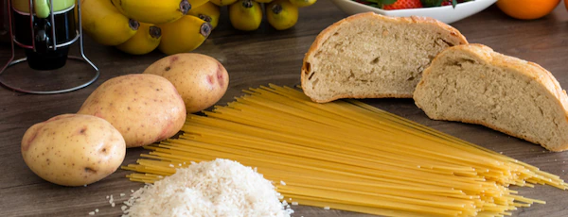
How can I reduce my fibre intake?
Ways to limit your fibre intake:
  Use white-based cereal products (white bread, white rice, white pasta, Cornflakes or Rice Krispies)
  Choose small portions of fruit and vegetables and remove skins, stalks, seed and pips
  Avoid nuts and dried fruit
  Limit your intake of pulses (beans, chickpeas or lentils) unless you are vegetarian when you should include one portion a day for protein

Slide 13
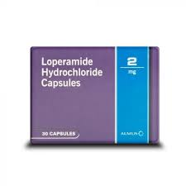
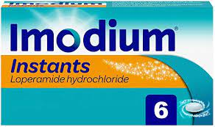
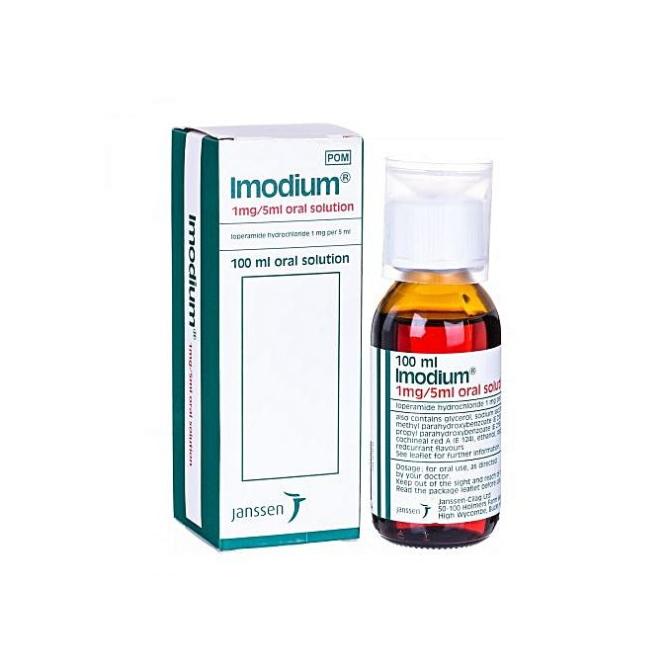
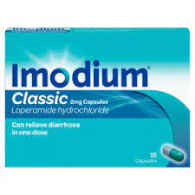
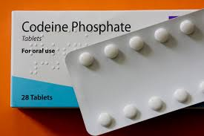
Medications
Loperamide (capsule or orodispersible)
Codeine
Antisecretory agents – omeprazole, lansoprazole
30 to 60min before food

Slide 14
What if I am losing weight?
Choose protein foods like meat, fish, eggs, quorn or tofu at each meal
Choose full fat dairy products such as full fat milk, cheese and yoghurts
Eat starchy foods like bread, cereals, potatoes, rice or pasta at each meal
If your appetite is poor, take smaller meals with regular snacks
Fortify your meals:
  Add 4 tablespoons of skimmed milk powder to 1 pint of whole milk and use on cereals, puddings and beverages.
  Add margarine, butter or grated cheese to vegetables, potatoes and soups.
  Try adding custard, double cream or ice cream to puddings for extra energy

Slide 15

QUESTIONS?

